Slide 1


BANKING CUSTOMER CHURN
Presentated by Nicole Bosibori

Slide 2
Introduction
It is useful for analyzing factors influencing customer churn to identify customers at risk of leaving, helping banks enhance customer retention strategies.

Slide 3

BUSINESS UNDERSTANDING
Customer churn is a critical concern for banks, as retaining existing customers is often more cost-effective than acquiring new ones. By analyzing the factors that lead to customer churn, banks can develop targeted strategies to improve customer satisfaction and loyalty.

Slide 4
PROBLEM STATEMENT
The aim is to pinpoint why customers leave our bank and to predict those at risk. Using demographic, financial, and behavioral data, we'll develop strategies to improve customer retention.

Slide 5




Objectives
To accurately predict customer churn
To understand the distribution and relationships of various features and identify patterns associated with customer churn.
Generate Insights and Recommendations

Slide 6
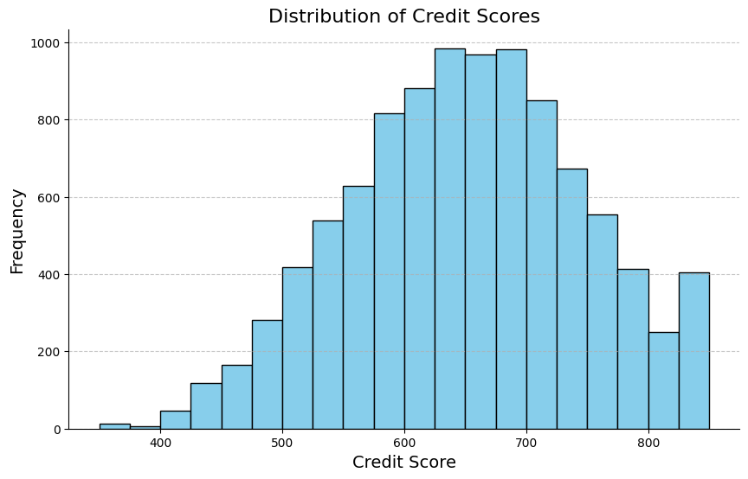
Credit Score Distibution
The majority credit score is between 600 and 700 and the least is between 0 and 400

Slide 7
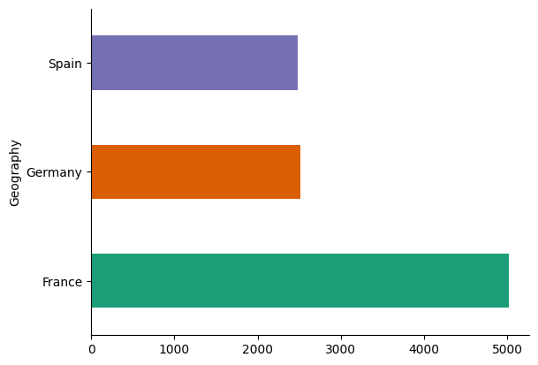
Distribution of Georgraphy
Majority of the customers are in France followed by Germany then Spain

Slide 8
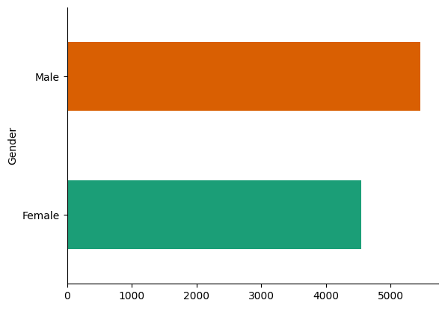
Gender Analysis
Majority of the customers are male while minority is female

Slide 9
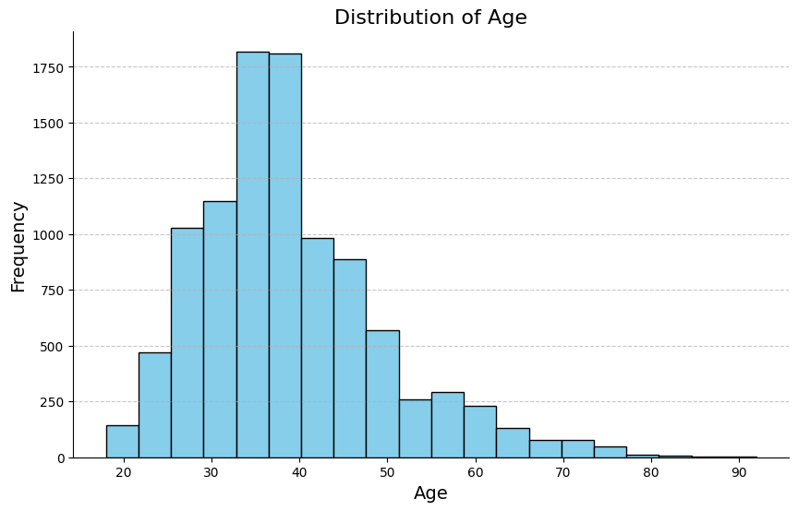
Age Distribution
Majority of the customers are between the age of 30 and 40

Slide 10
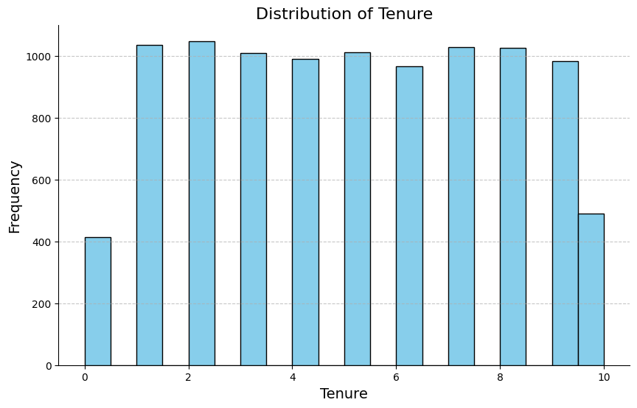
Tenure
Majority of the customers have been with the bank number for 2 years.

Slide 11
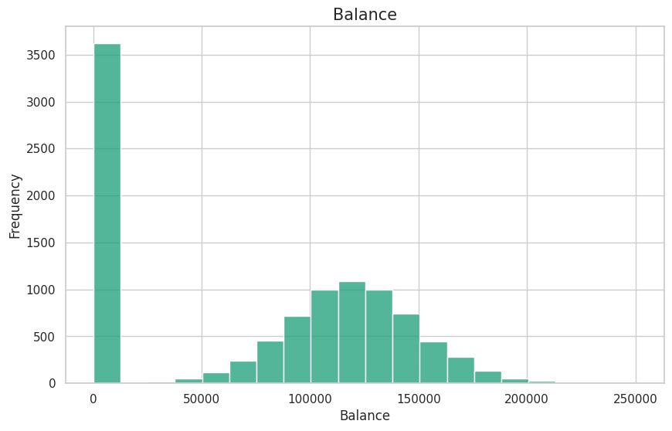
Balance Analysis
Majority of the clients have 0 balance

Slide 12
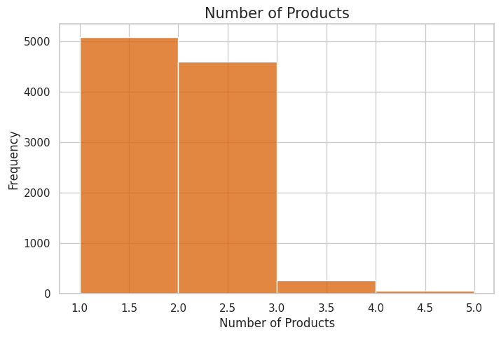
Products Purchased by customers
Majority of the customers have 1 to 2 bank products

Slide 13
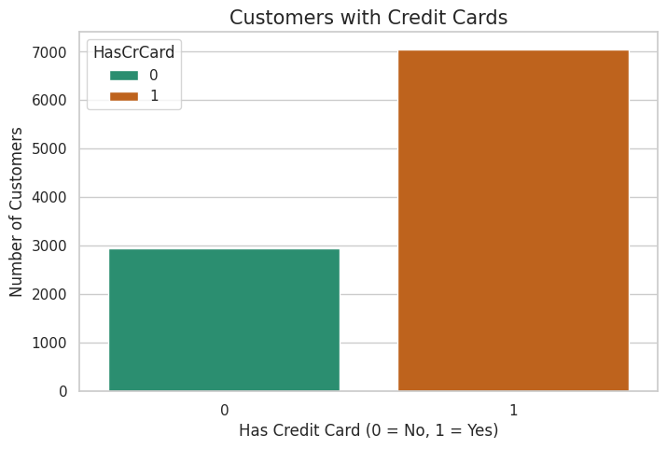
Customers with Credit Cards
Majority of the customers have credit cards

Slide 14
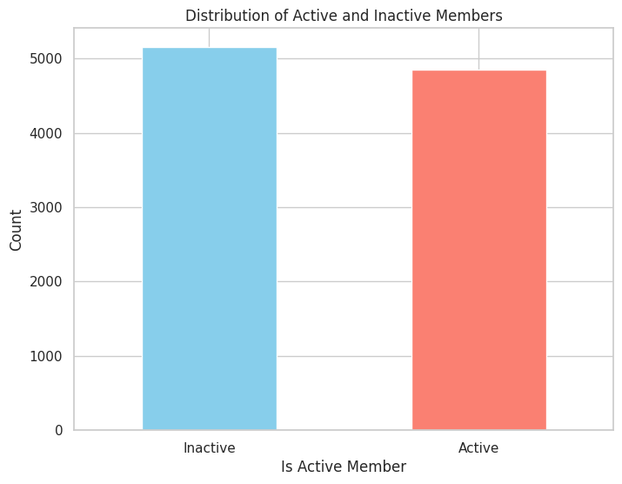
Member Status
Majority of the customers are inactive but compared to active members very few are inactive

Slide 15
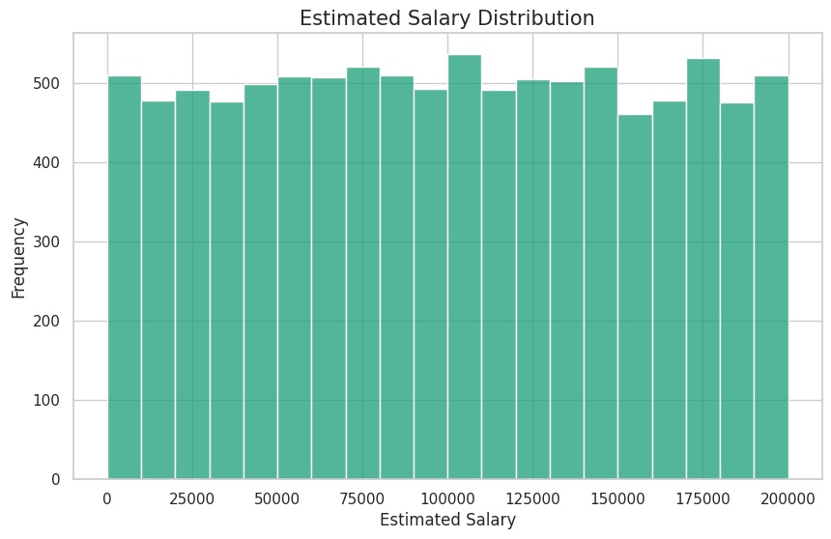
Customer estimated Salaries
Majority Estimated Salary is 100,000

Slide 16
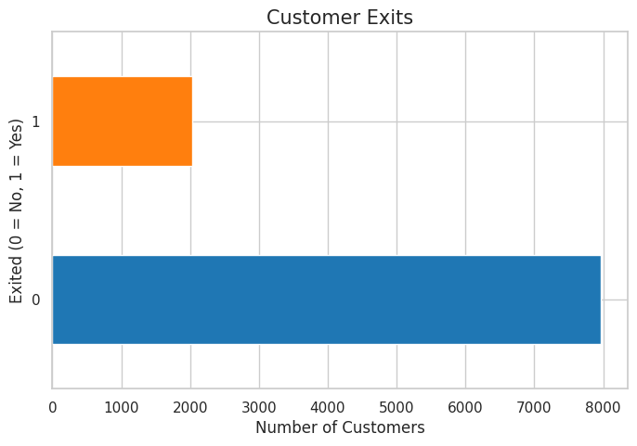
Count of customer Churn
Only a few customers exited the bank

Slide 17
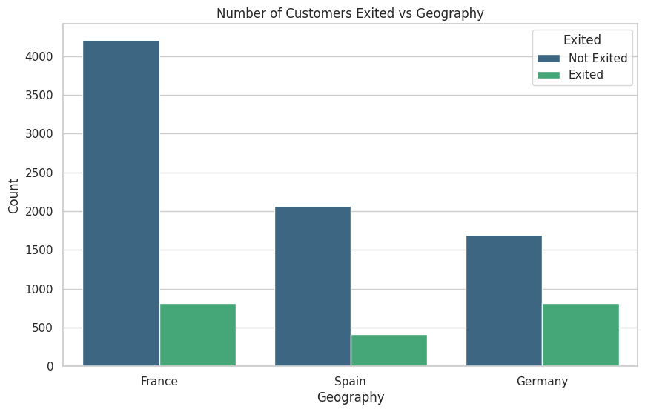
Customer Churn Vs Geography
In all countries minority of the customers exited where spain had the list customer churns and Germany had the most

Slide 18
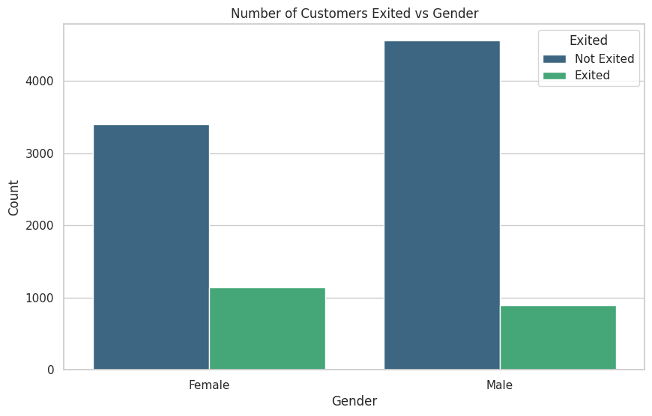
Customer Churn Vs Gender
More female customers exited than the male ones

Slide 19
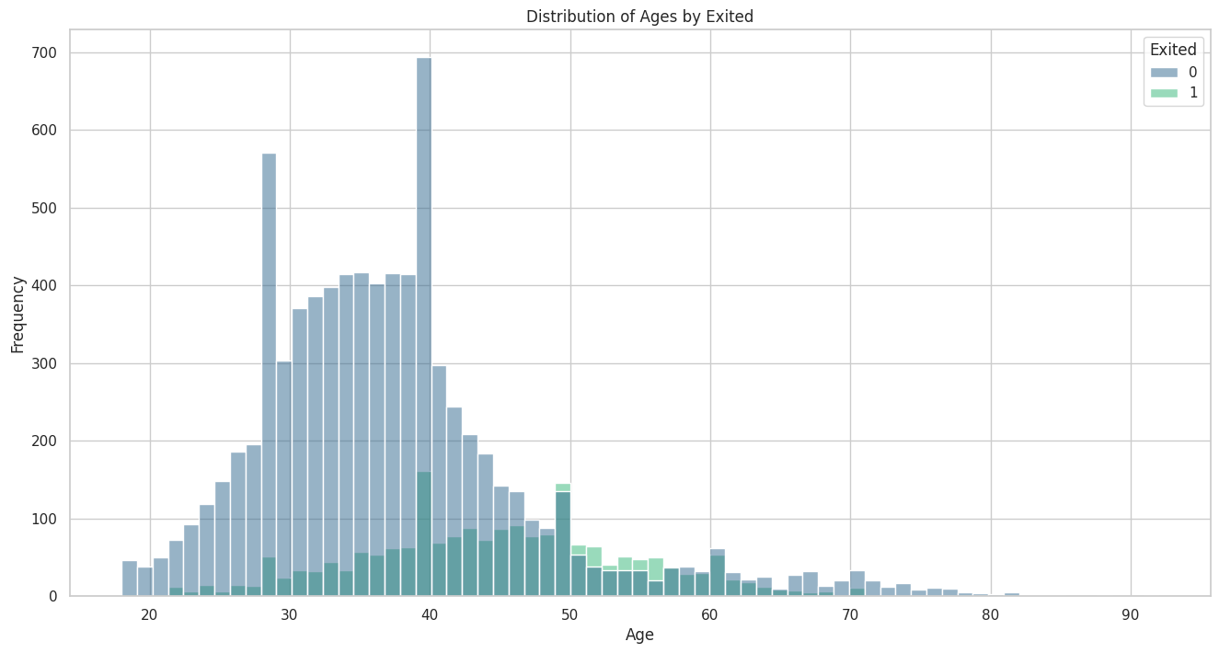
Majority of the customers are around the age of 40 while they are still the majority that exited and stayed

Slide 20
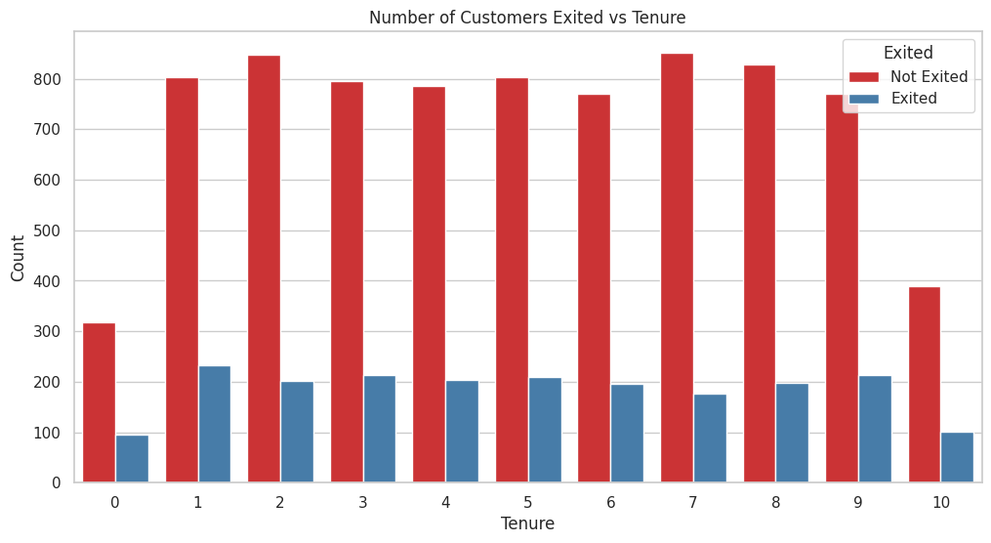
Considering the tenur and exiting the customers with the highest tenur(10) and the least tenur (0) exited the least

Slide 21
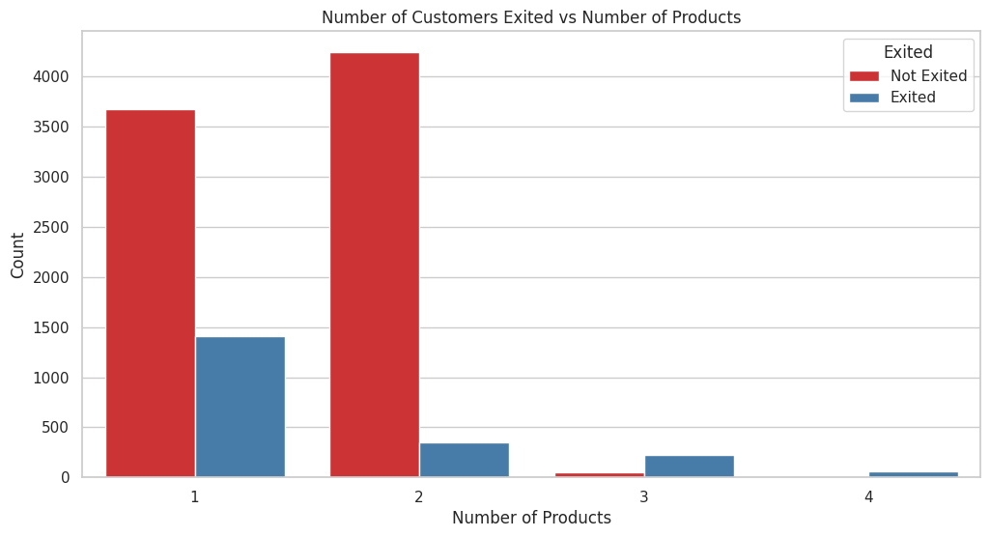
Most customers have 2 products and majority of the customers that exited had 1 product
least number of exits had 4 products

Slide 22
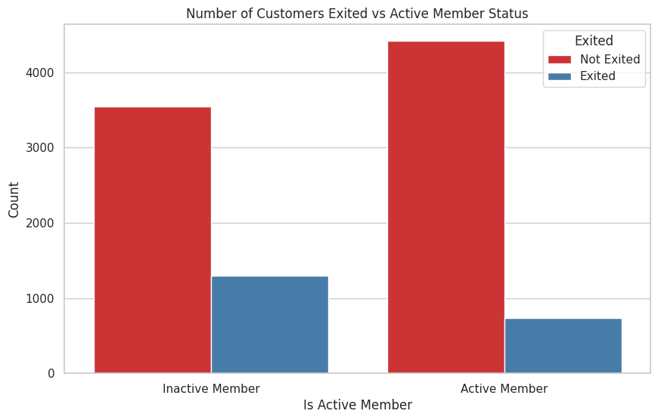
Most inactive customers exited the bank

Slide 23
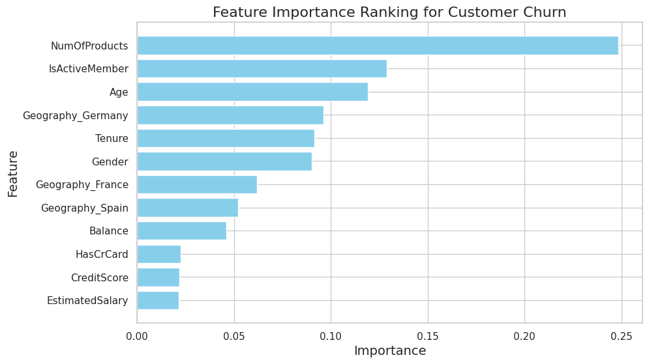
The key factors influencing customer churn are the number of products, active membership status, and age. Geographic location, tenure, and gender also play important roles. Less influential factors include balance, having a credit card, credit score, and estimated salary.

Slide 24

01
Enhance Product Offerings: Focus on increasing the number of products per customer to improve retention.
02
Engage Active Members: Develop strategies to keep members active and engaged.
Recommendations
03
Target Specific Demographics: Tailor retention strategies based on age and geographic location.
04
Improve Customer Experience: Focus on high-tenure and gender-specific needs to enhance satisfaction.

Slide 25
Customer Engagement Programs: Develop and launch targeted retention campaigns based on model insights.
01
02
Training and Support: Provide training sessions for staff on using the new predictive model and interpreting its outputs.
NEXT STEPS
Communication Strategy: Communicate the benefits of the predictive model to stakeholders and customers to ensure buy-in.
03
Monitor Impact: Regularly review the impact of retention strategies on customer churn rates and adjust accordingly.
04

Slide 26
Thank you

